Slide 1


Machine Learning Workshop: Hands-On Projects
Welcome to this practical workshop where we'll dive into two real-world machine learning projects. Get ready to learn essential concepts and build your data science skills through hands-on coding.
by Muhammad Ibrahim Qasmi

Slide 2
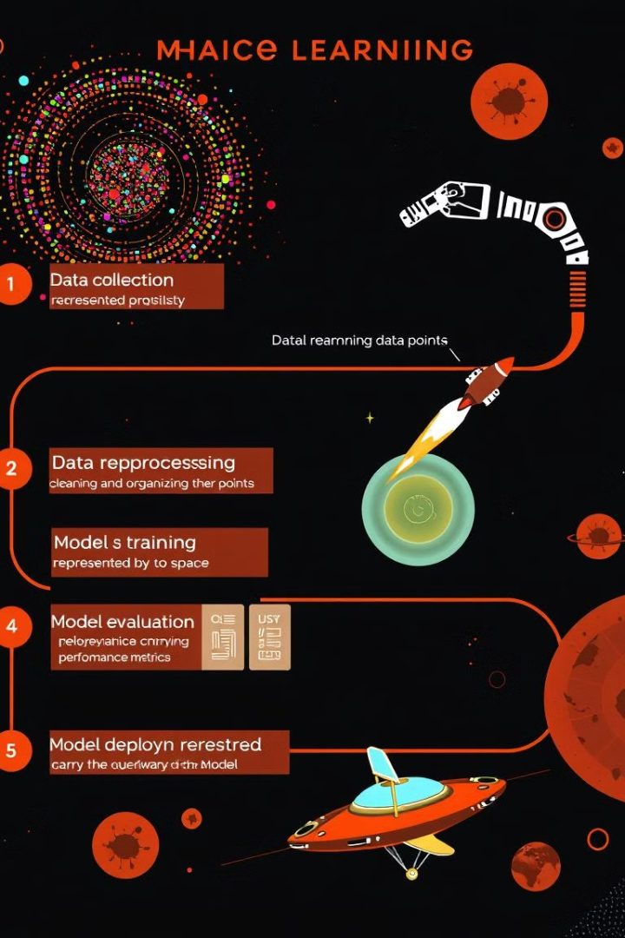
Workshop Overview
Two Projects
Classification & Regression
We'll work on two engaging machine learning projects: Titanic Survival Prediction and Restaurant Tips Prediction.
The projects focus on two fundamental machine learning tasks: classification and regression.
Key Concepts
You'll learn key concepts like data preprocessing, model building, and performance evaluation.

Slide 3
Project 1: Titanic Survival Prediction 🚢
Classification Problem
Passenger Characteristics
Survival Prediction
We'll build a classification model to predict whether passengers survived the Titanic disaster.
The model will use passenger data like age, class, and ticket fare as input.
The output will be a binary prediction: whether the passenger survived (Yes or No).

Slide 4
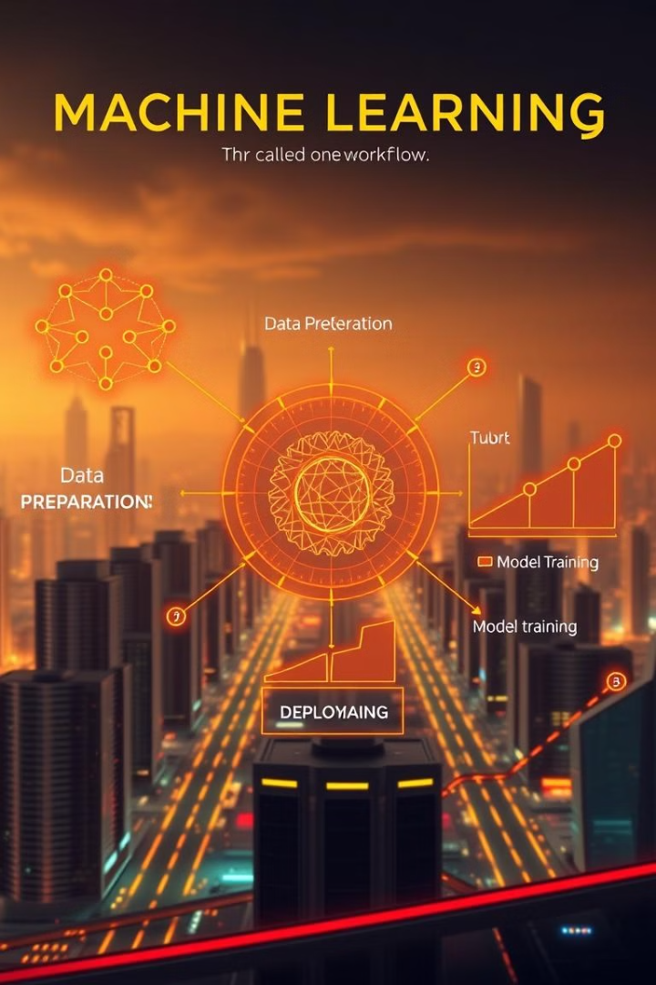
Titanic Project: Code Walkthrough
1
Data Exploration
We'll start by loading the Titanic dataset and exploring its structure and key statistics.
2
Data Preprocessing
We'll handle missing values, create new features, and encode categorical variables.
3
Model Training
We'll train a Logistic Regression model to predict survival using our prepared data.
4
Model Evaluation
We'll evaluate the model's performance using metrics like accuracy, precision, and recall.

Slide 5

Project 2: Restaurant Tips Prediction 💰
Regression Problem
Bill Details
We'll build a regression model to predict the amount of tip a customer will leave.
The model will use bill details like the total cost, size, and day of the week as input.
Tip Amount
The output will be a continuous value representing the predicted tip amount.

Slide 6
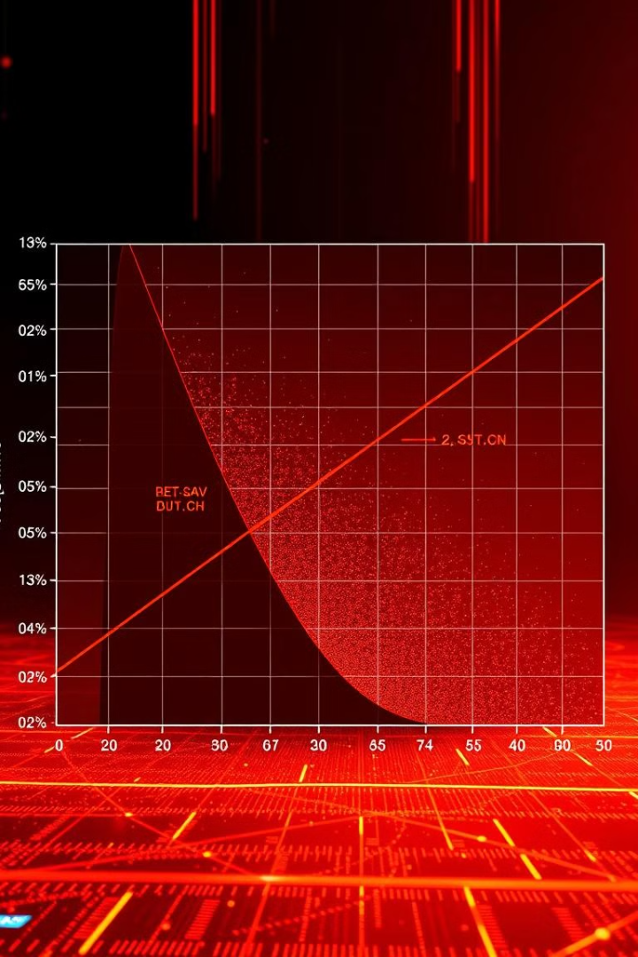




Tips Project: Code Walkthrough
Data Exploration
Data Preprocessing
We'll load the Tips dataset and analyze its features and the distribution of tip amounts.
We'll encode categorical features and create new features to improve model accuracy.
Model Training
Model Evaluation
We'll train a Linear Regression model to predict tip amount based on our prepared data.
We'll evaluate the model's performance using metrics like MSE and R-squared score.

Slide 7




🌟 Workshop Key Takeaways
1
Problem Solving
2
Data Preprocessing
3
Algorithm Selection
4
Visualization

Slide 8
Next Steps in Machine Learning
Explore Datasets
1
Practice with more complex datasets to gain experience with diverse data structures.
Advanced Algorithms
2
Experiment with advanced algorithms like Random Forest and Support Vector Machines.
Real-World Applications
3
Apply your knowledge to real-world problems and build projects that solve practical issues.

Slide 9
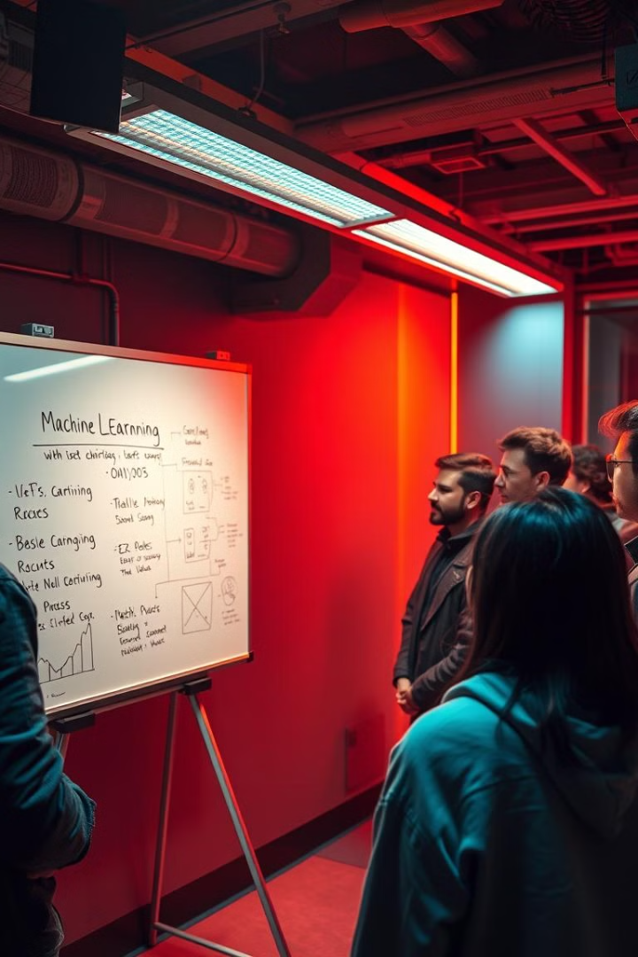
Q&A and Discussion
Let's open up the floor for questions, share experiences, and discuss the challenges you've encountered. Keep exploring and learning in the exciting world of machine learning!

